Slide 1
Virtual Patient Simulation
Curtis K. Johnston & Shen Cheng
11/01/2024

Slide 2
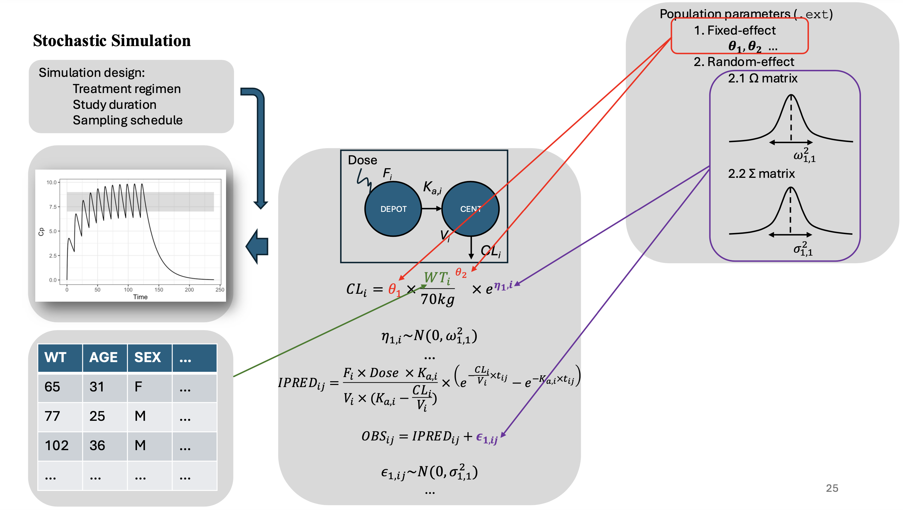

Slide 3
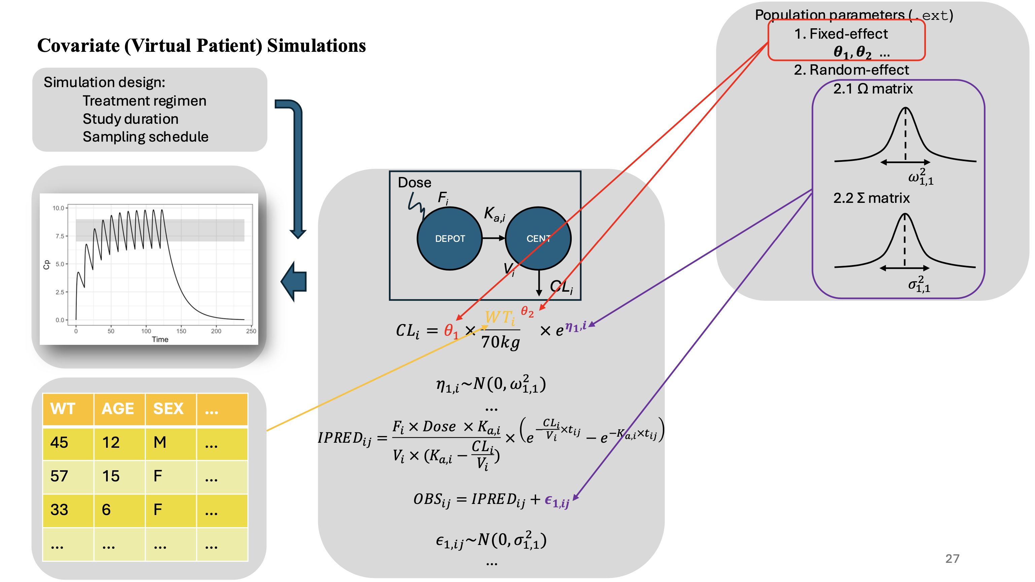

Slide 4
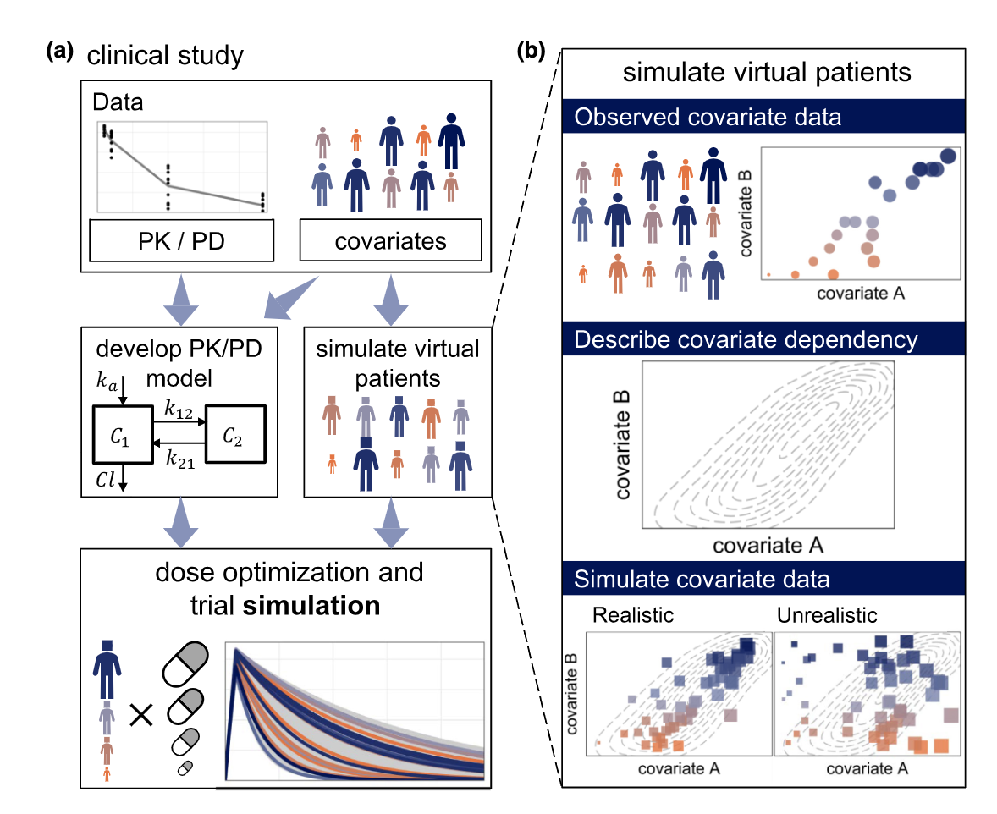
“Realistic” Virtual Population
Difficulties in simulating realistic virtual population:
Different covariates exhibit different distributions (i.e., marginal distributions)
Intricate dependency structure (i.e., correlation)
Unrealistic virtual patient example:
A patient of 95 years old, with a high body weight and a very good kidney.
Failing to consider such correlations inflate the variability of covariates, in other words, unrealistic virtual patients.
Zwep LB et al., Clin Pharmacol Ther. 2023

Slide 5
Methods of Virtual Patient Simulations
Data (Resample)-based methods
Bootstrap
Conditional distributions
Also known as Multiple Imputation by Chained Equations (MICE)
Distribution-based methods
Marginal distributions
Multivariate normal distributions (MVND)
Copula modeling
Population Data
Direct
Virtual population
Indirect
Population Data
Population distribution
Virtual population

Slide 6
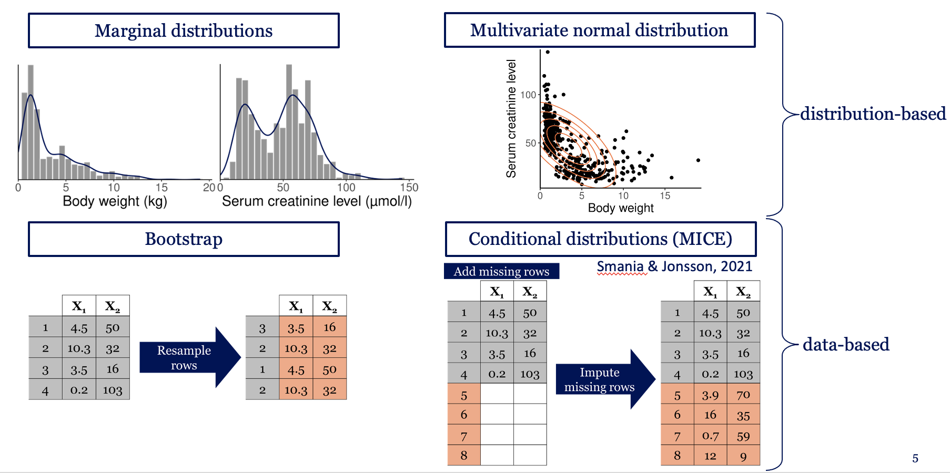
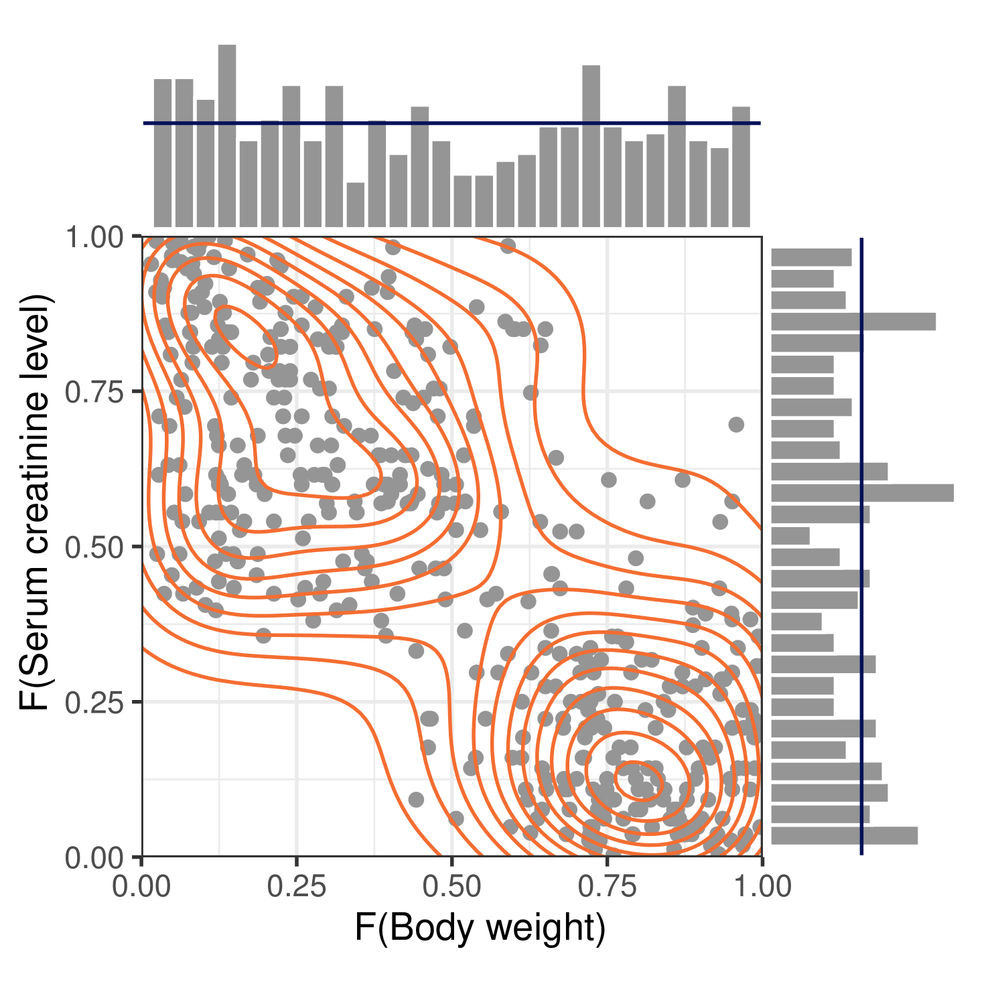
Methods of Virtual Patient Simulations
Need actual data
Cannot extrapolate
Need actual data (indirectly)
Copula modeling
Ignore correlations
Distributional assumptions
Zwep LB et al., PAGE. 2022

Slide 7
Distribution-Based Methods
Marginal distributions
Multivariate normal distributions (MVND)
Copula modeling

Slide 8
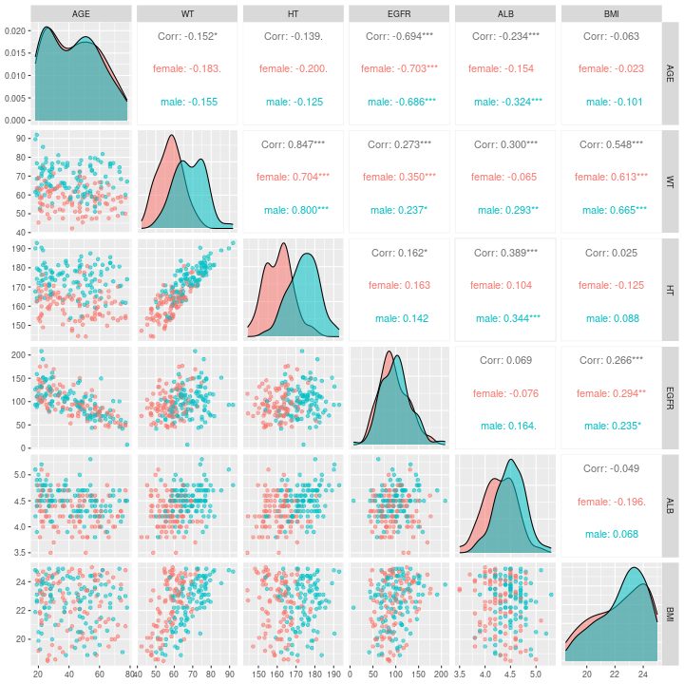
Population Data
./wk9/data/pop.csv
Seven covariates:
Continuous:
AGE: age in years
WT: body weight in kg
HT: height in cm
EGFR: estimated glomerular filtration rate in mL/min
ALB: albumin concentration in g/dL
BMI: body mass index in kg/m²
Categorical:
SEX: gender (male vs female)

Slide 9
Experiments
Separate the population data based on SEX (male vs female)
Derive two distributions, one for male, one for female, using different method:
Marginal distributions
Multivariate normal distributions
Copula modeling
Simulate from the derived distributions
Compare the simulated data with the population data, determine which method simulate the most “realistic” data (i.e., most similar to population data).

Slide 10
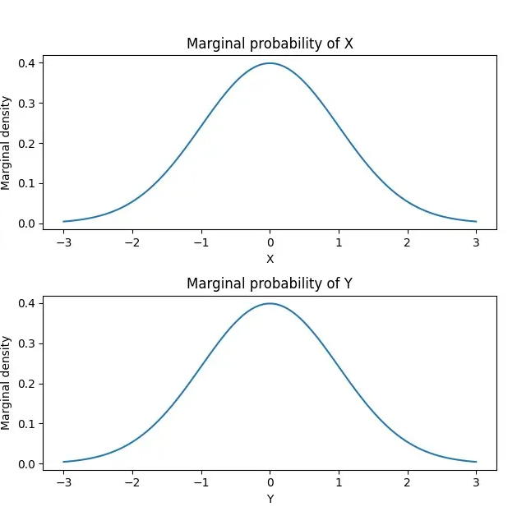
Marginal Distributions
Derive the means and standard deviations (SDs) of each variable in the population dataset.
Sample from a (truncated) normal distribution (or other distributions) with the same mean and SD of each variable.
Meccanismo Complesso. Marginal probability. 12/11/2023

Slide 11
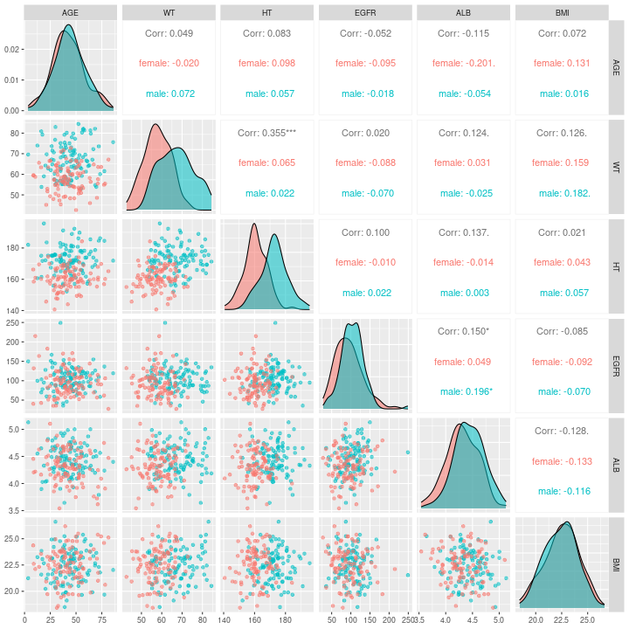
Marginal Distributions

Slide 12
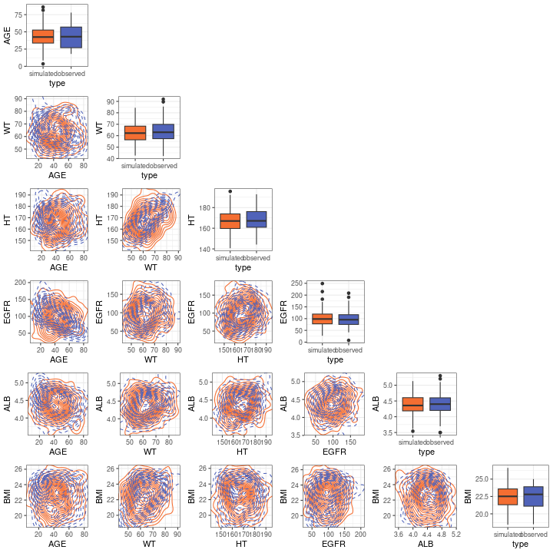
Marginal Distributions

Slide 13
Summary-Marginal Distributions
Simulation ignoring correlations (i.e., joint distribution)
Unrealistic simulation
Unrealistic combination of covariates
Low weight + high BMI/height
High age + high eGFR
Easy to implement
Not appropriate to use when high-dimensional covariates were simulated

Slide 14
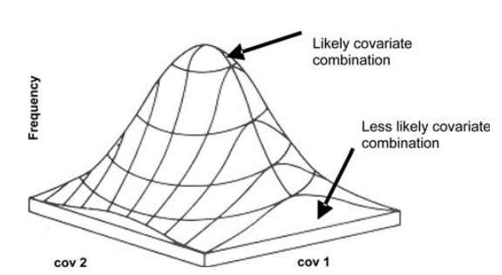
Multivariate Normal Distributions
Derive the means and the covariance matrix of the population dataset.
Sample from the multivariate normal distribution defined by the means and the covariance matrix .
Tannenbaum et al. 2006. Journal of Pharmacokinetics and Pharmacodynamics

Slide 15
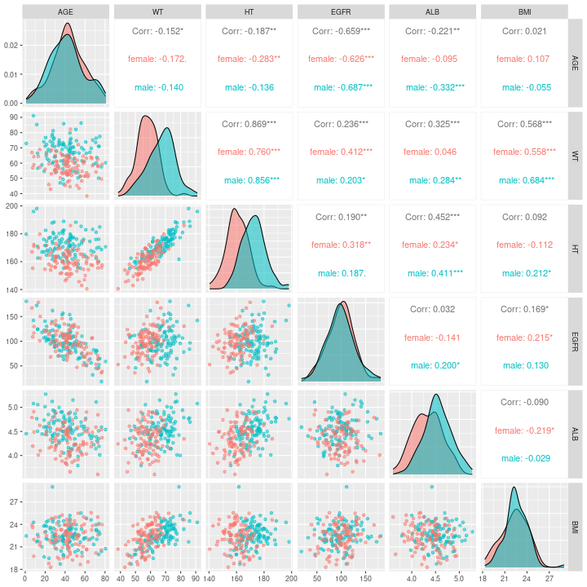
Multivariate Normal Distributions

Slide 16
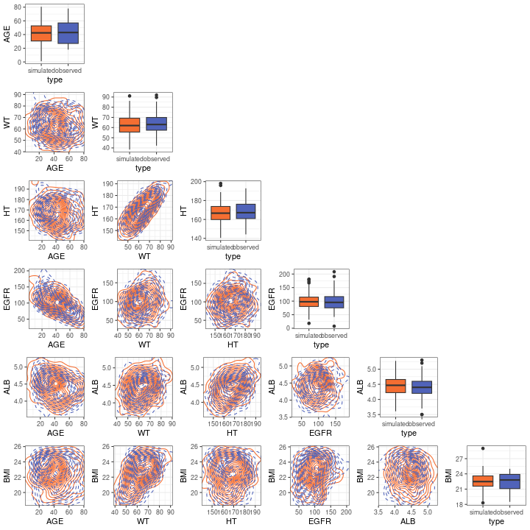
Multivariate Normal Distributions

Slide 17
Summary-Multivariate Normal Distributions
Simulation considering both marginal and joint distribution
More realistic simulation
Realistic combination of covariates
Strong distributional assumptions
Normal marginal distribution
Linear correlation

Slide 18
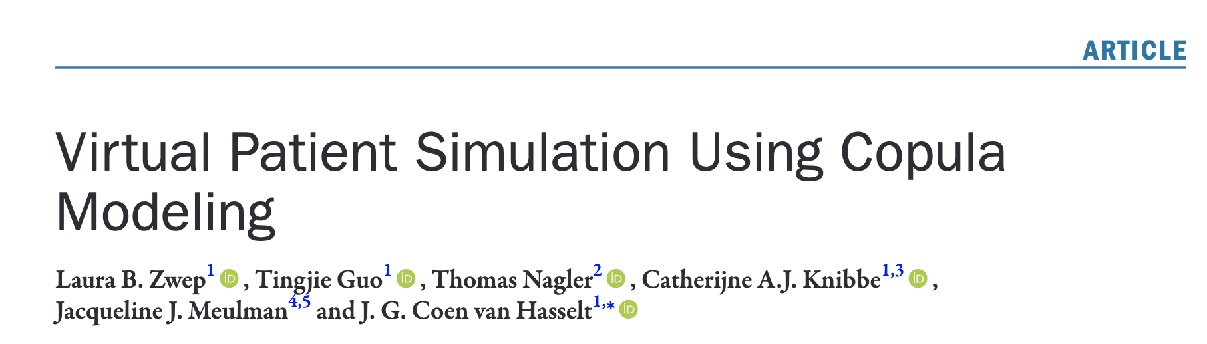
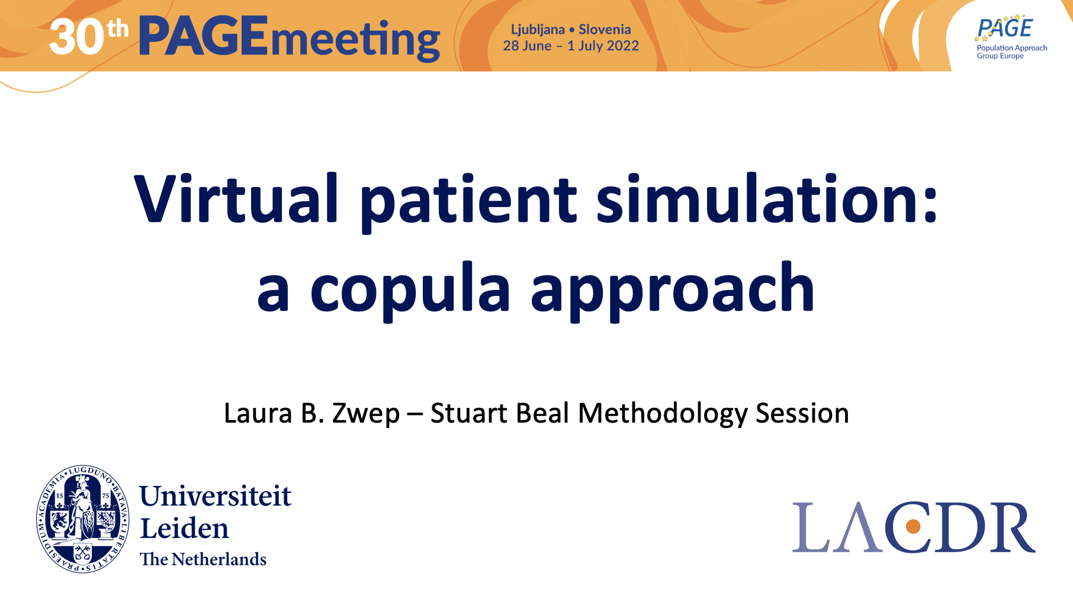
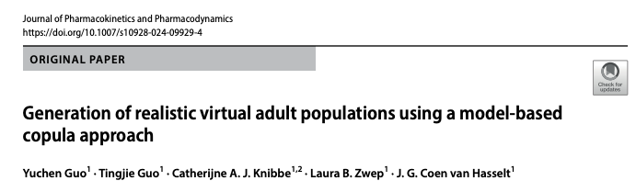
Copula Modeling

Slide 19
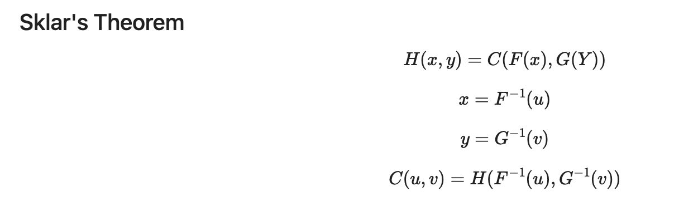
Sklar’s Theorem
Joint distribution
Copula
Marginal distribution
Kiran Karra. Copula Short Course. Youtube

Slide 20
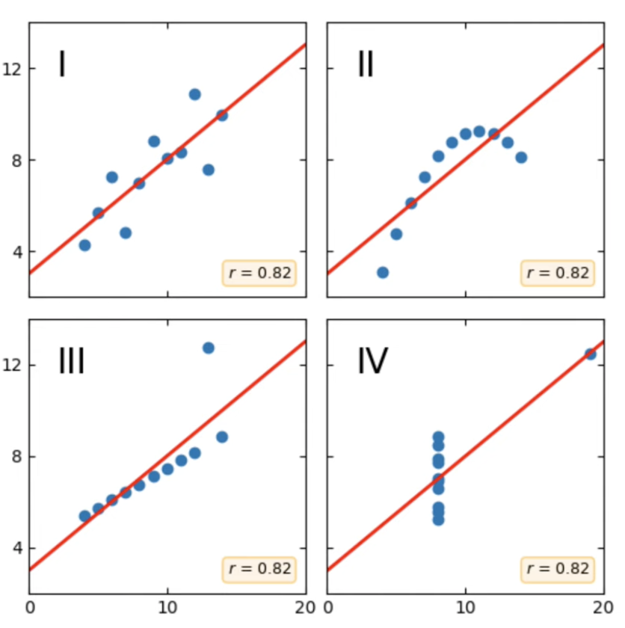
Why copula?
Kiran Karra. Copula Short Course. Youtube

Slide 21
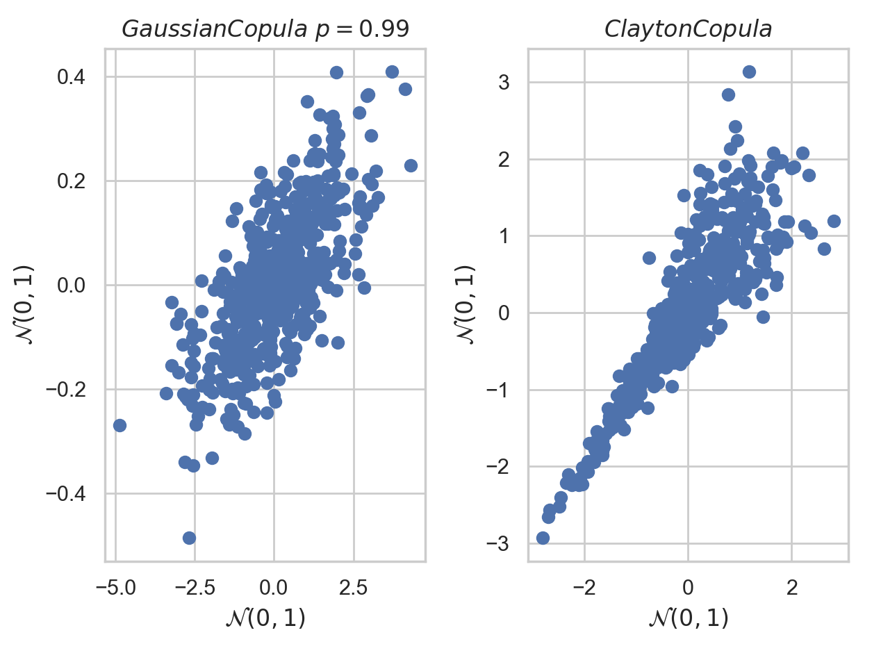
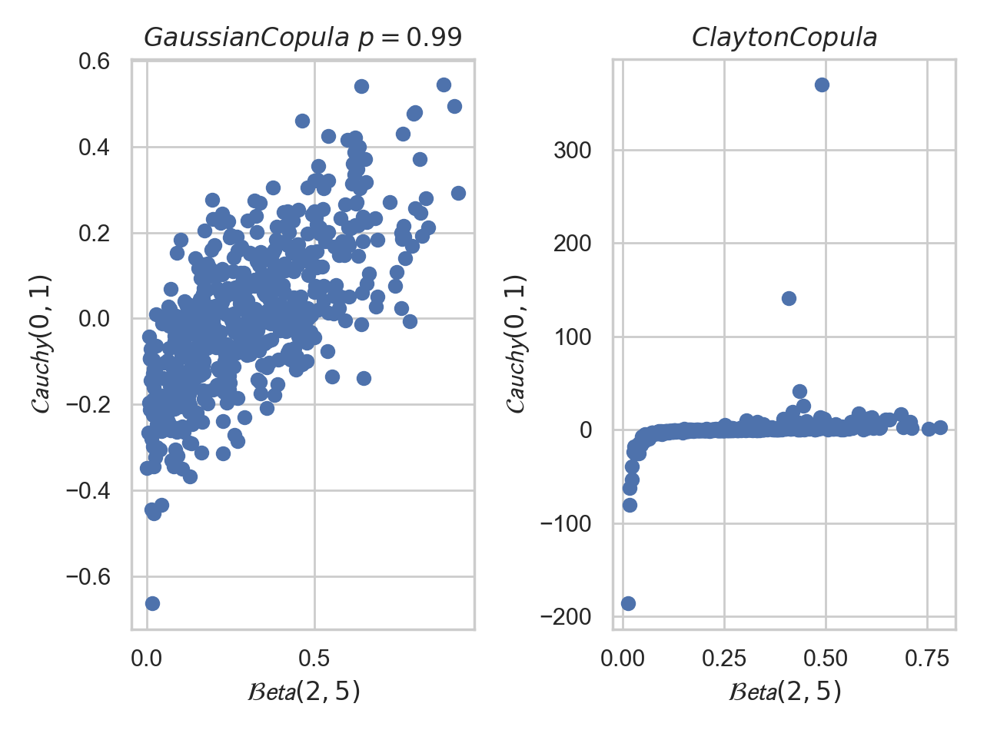
Why copula?
Kiran Karra. Copula Short Course. Youtube

Slide 22
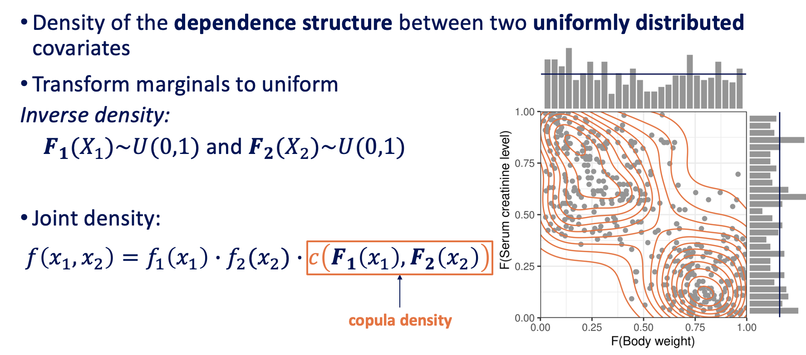
Copula: general process
Transform marginal distributions into uniform distributions
Develop copula model
Vine copula: rvinecopulib
Copula selection using AIC
Simulations
Transform the simulated uniform distributions into the original marginal distributions
Zwep LB et al., PAGE. 2022

Slide 23
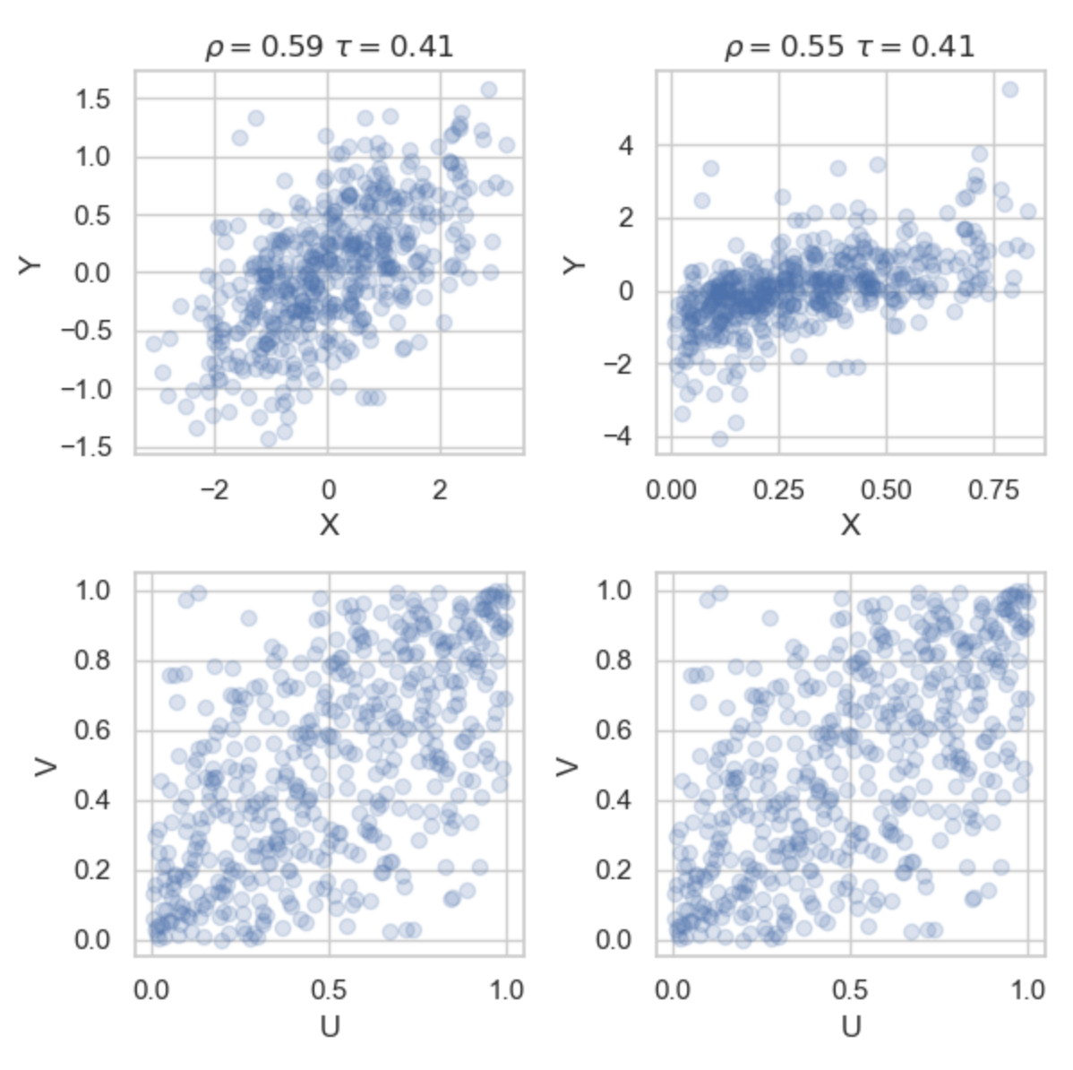
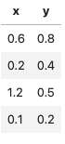
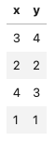
The advantage of the uniform marginal distributions
Separate a joint distribution into marginal distributions and the dependence structure
Standardize copula modeling, more flexible and efficient to model the complex joint distribution
Rank correlation (Kendell’s tau) is independent of marginal distributions (simplicity and robustness)
Original observations
Rank observations
Kiran Karra. Copula Short Course. Youtube

Slide 24
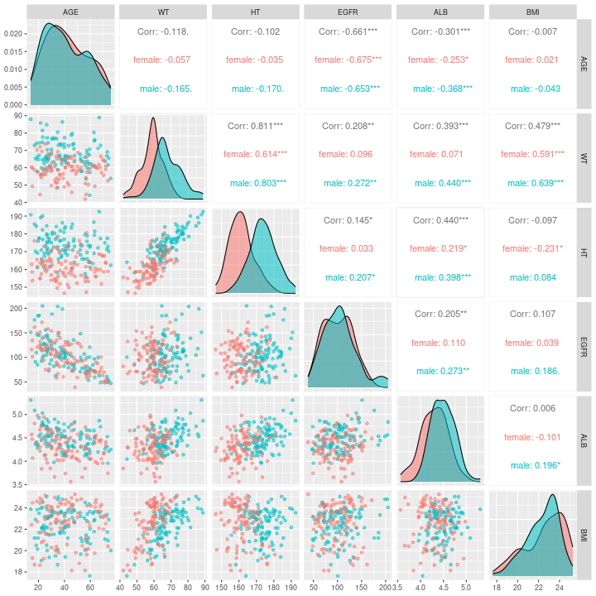
Copula Modeling

Slide 25
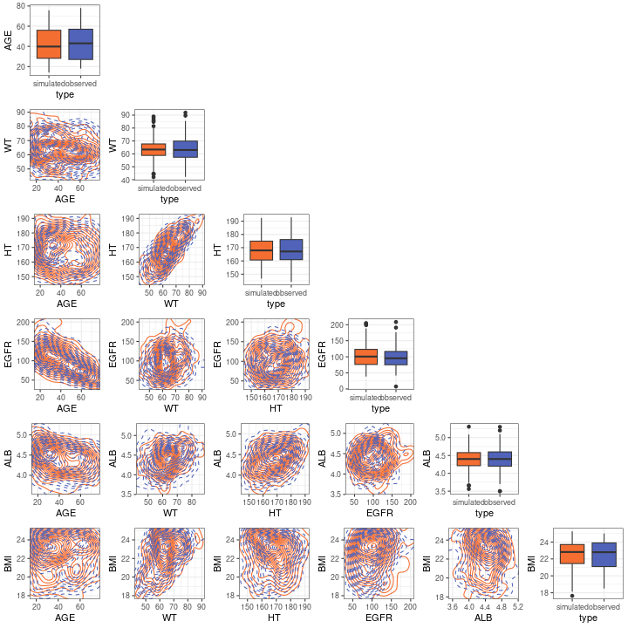
Copula Modeling

Slide 26
Copula resources
Laura B. Zwep, Tingjie Guo, Jacqueline J. Meulman, J.G. Coen van Hasselt. Copula modeling for realistic virtual patient covariate simulation. PAGE 2022
Zwep, L.B., Guo, T., Nagler, T., Knibbe, C.A.J., Meulman, J.J. and van Hasselt, J.G.C. (2024), Virtual Patient Simulation Using Copula Modeling. Clin Pharmacol Ther, 115: 795-804. https://doi.org/10.1002/cpt.3099
Github: https://github.com/vanhasseltlab/copula_vps
Guo, Y., Guo, T., Knibbe, C.A.J. et al. Generation of realistic virtual adult populations using a model-based copula approach. J Pharmacokinet Pharmacodyn (2024). https://doi.org/10.1007/s10928-024-09929-4
Github: https://github.com/vanhasseltlab/NHANES_copula
ShinyAPP: https://cocosim.lacdr.leidenuniv.nl/
Kiran Karra. Copula Short Course. Youtube

Slide 27
The End

